Slide 1
Deep Learning with PyTorch
Seth Juarez
@sethjuarez

Slide 2
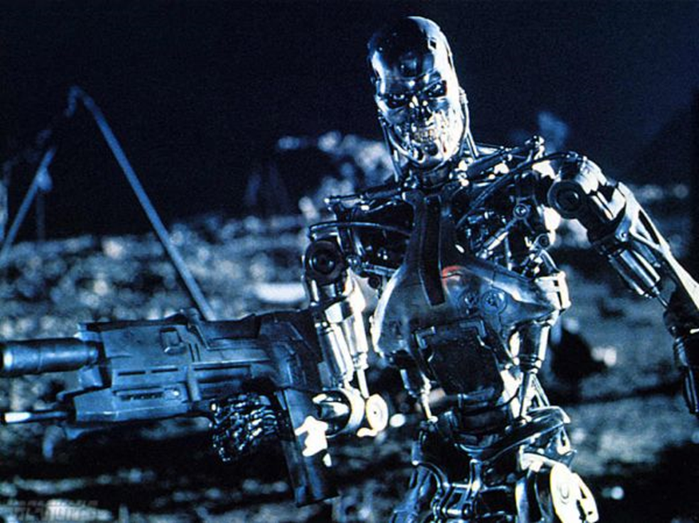
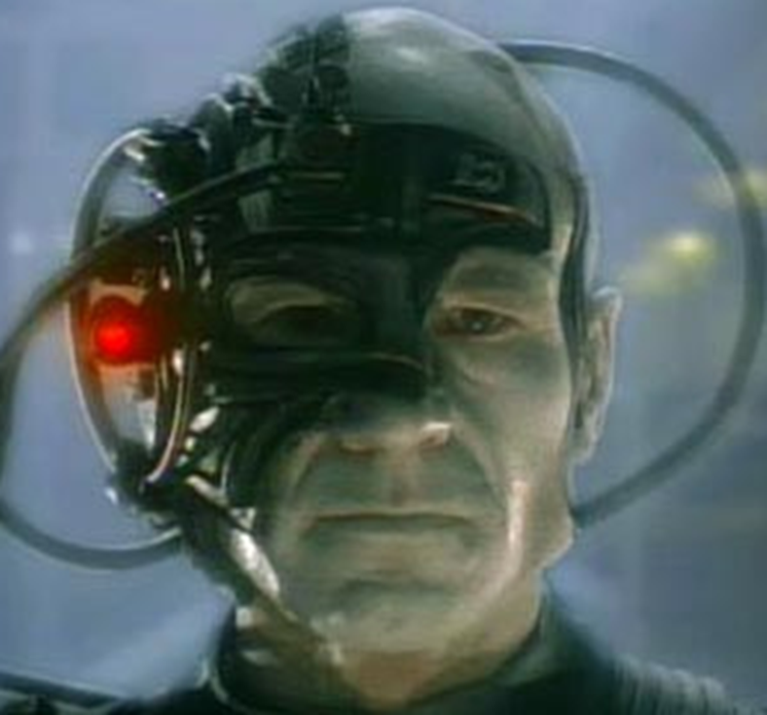


Slide 3


Slide 4
artificial intelligence
machine learning
deep learning

Slide 5

programming
algorithm
answers
input

Slide 6
machine learning
answers
algorithm
input

Slide 7

machine learning
PyTorch
model
data

Slide 8

machine learning
data
PyTorch
model / algorithm
code
answers
input

Slide 9


Slide 10
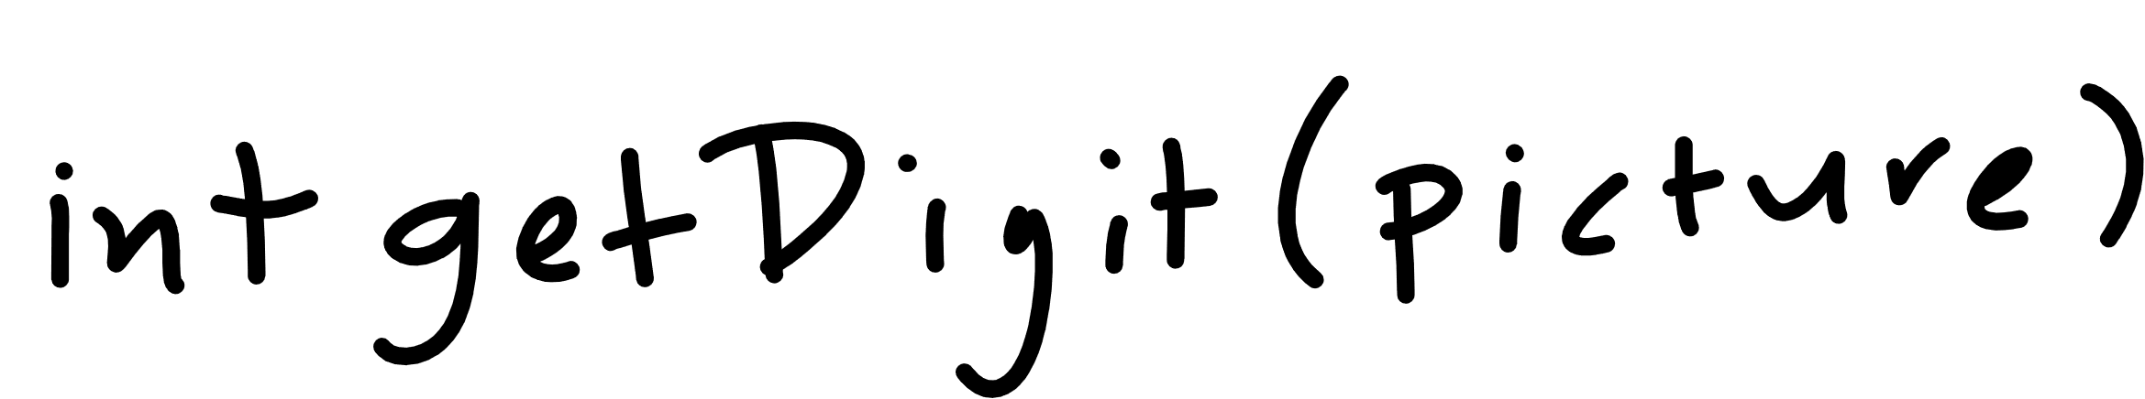

Slide 11
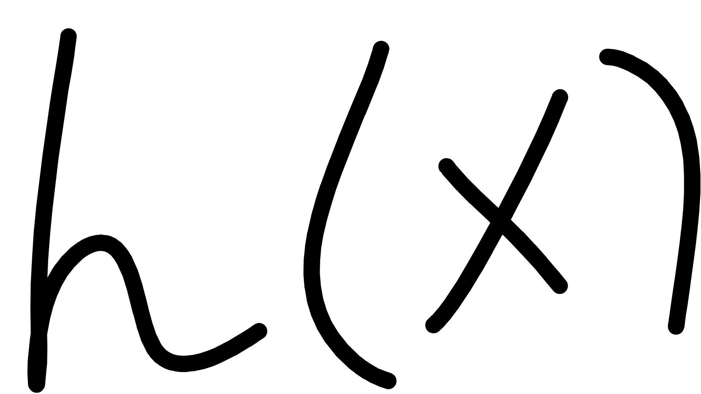
Notes:
Cover the fact that ML uses data to make its own functions

Slide 12
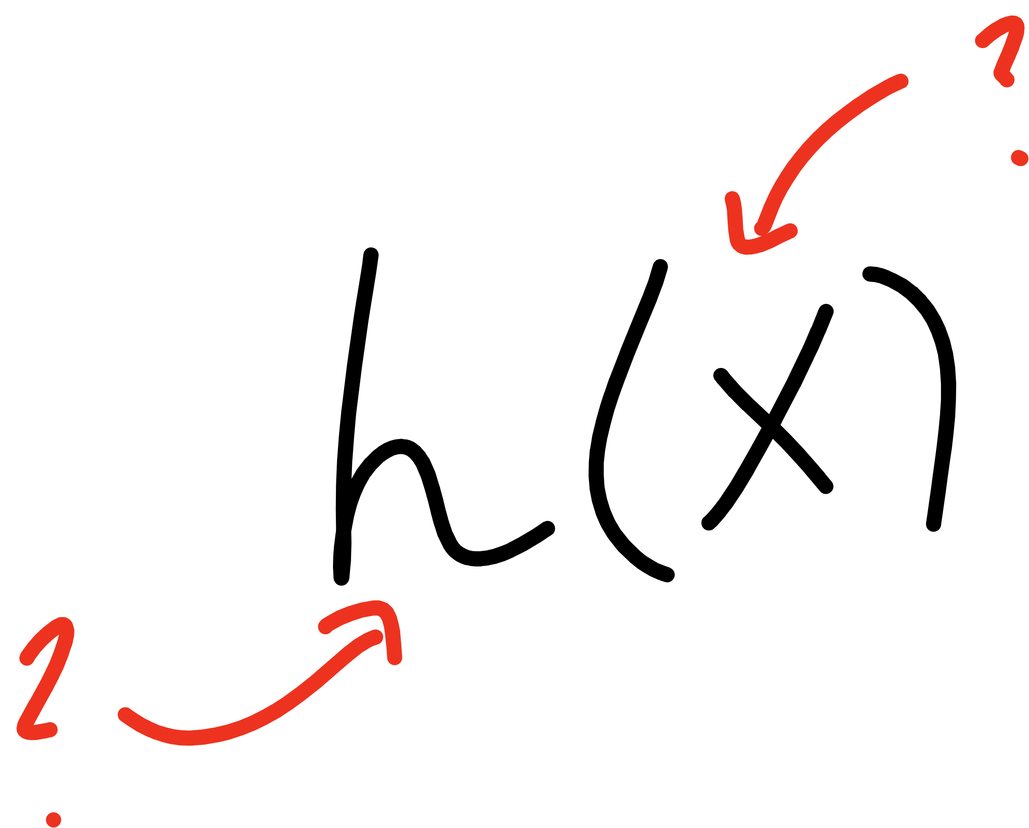
Notes:
Open mnist data representation

Slide 13
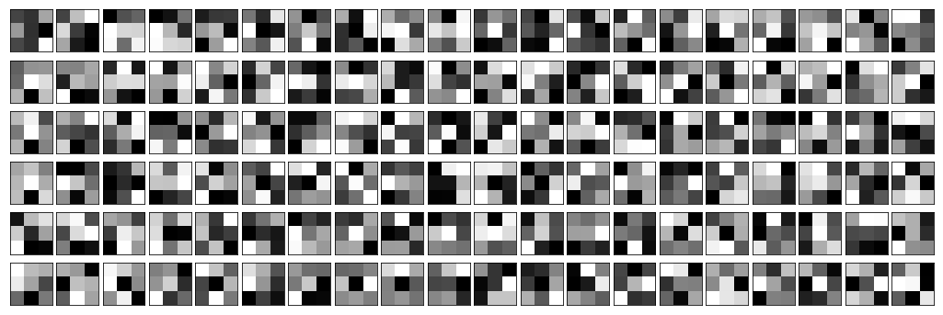
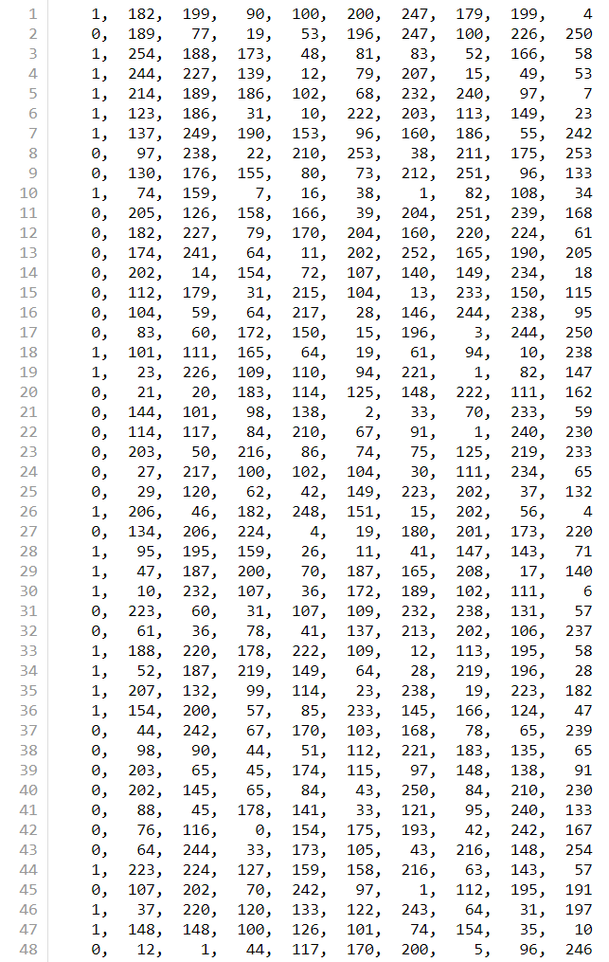


Slide 14
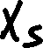
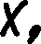
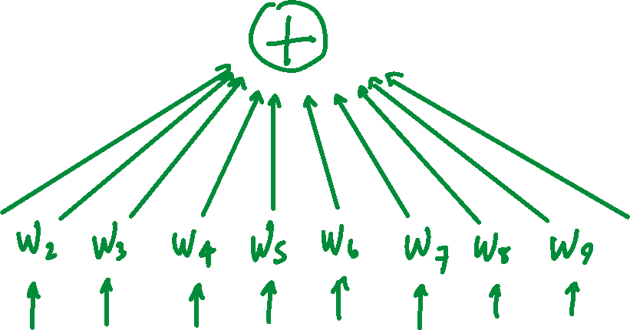
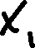

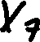

Slide 15
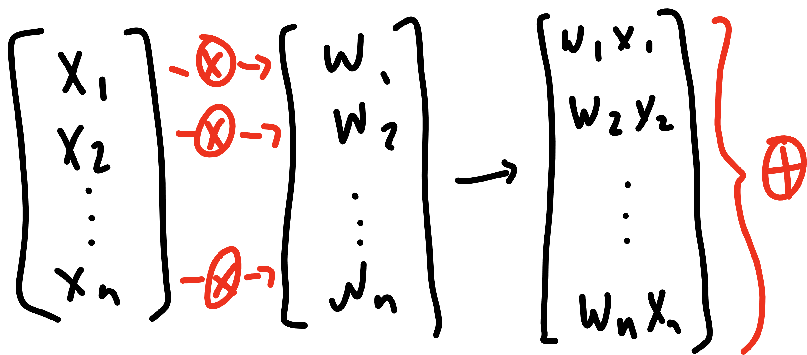

Slide 16
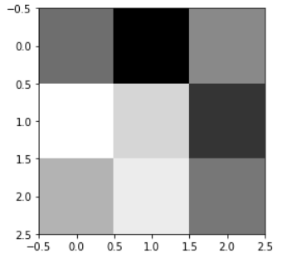
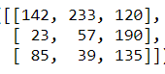
[142, 233, 120, 23, 57, 190, 85, 39, 135]

Slide 17
[ 1, 1, 1, 0, 0, 0, -1, -1, -1]
[142, 233, 120, 23, 57, 190, 85, 39, 135]
236

Slide 18
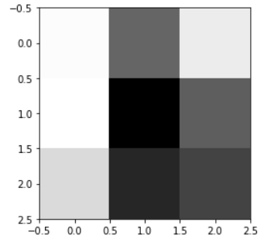
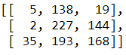
[5, 138, 19, 2, 227, 144, 35, 193, 168]

Slide 19
[ 1, 1, 1, 0, 0, 0, -1, -1, -1]
[5, 138, 19, 2, 227, 144, 35, 193, 168]
-234

Slide 20
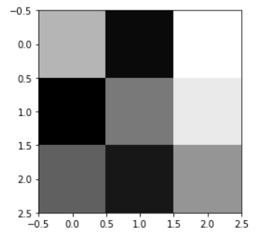









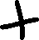

Slide 21






Slide 22












Slide 23










Slide 24

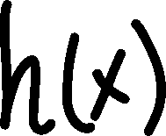


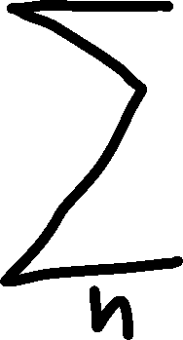




Slide 25








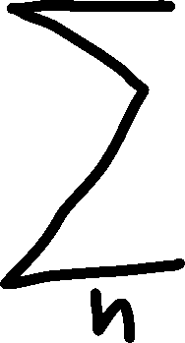


Slide 26
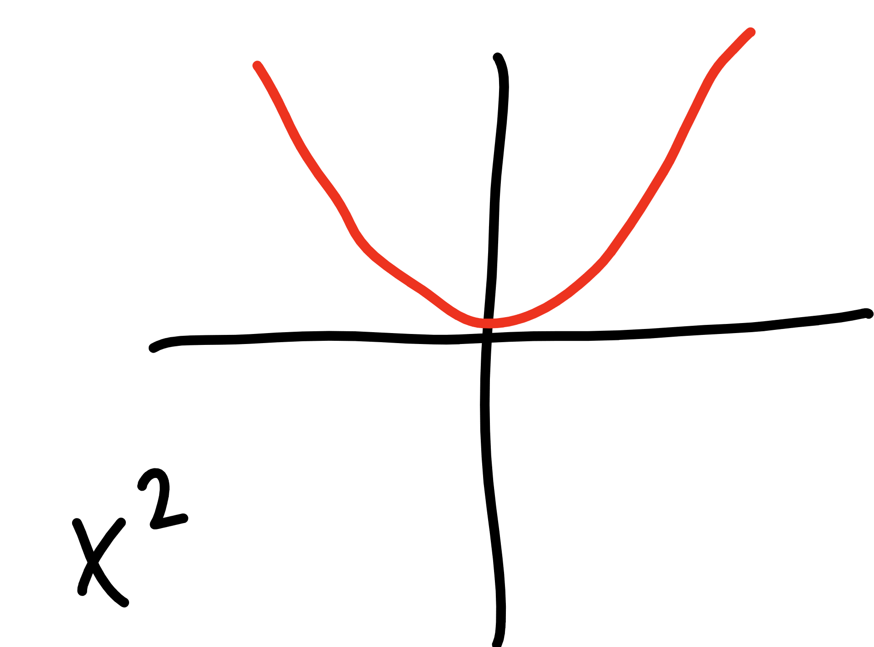

Slide 27
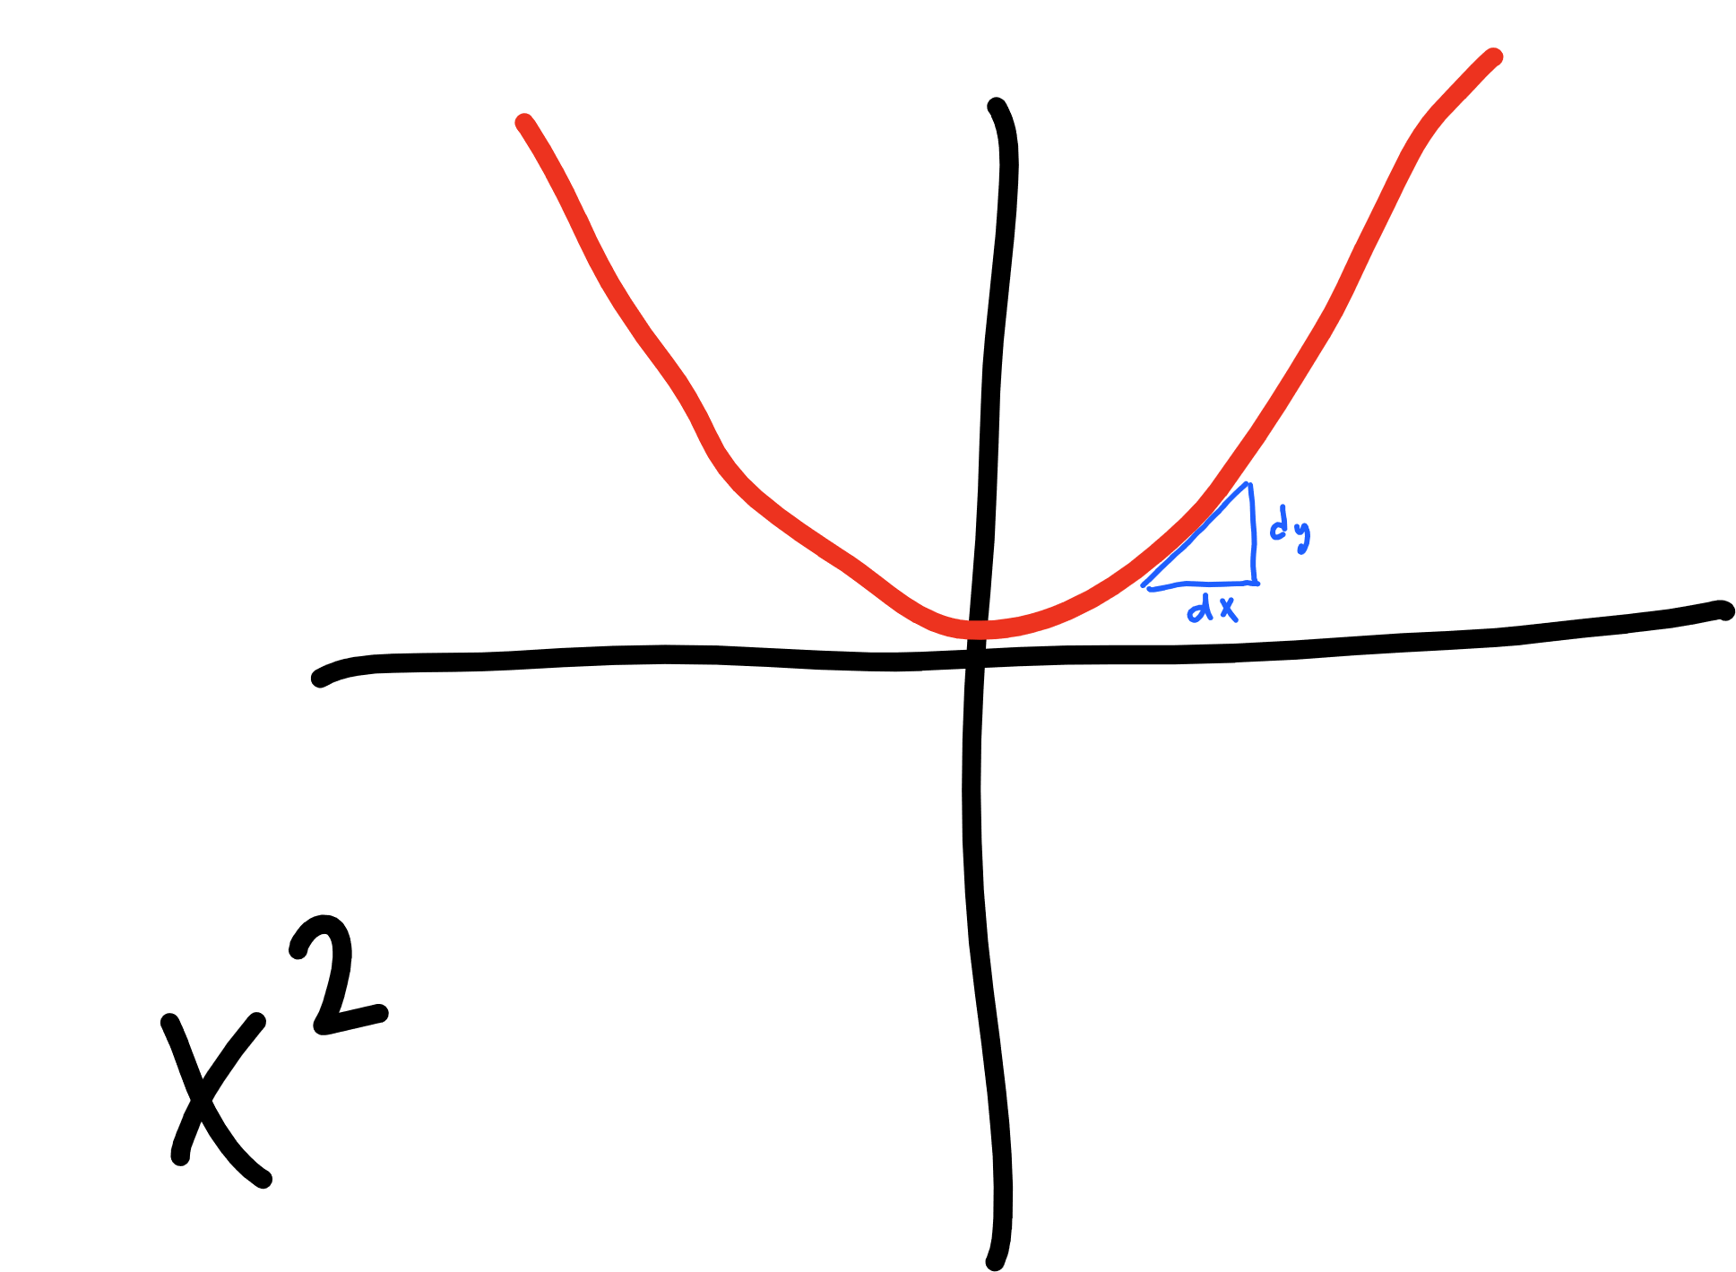

Slide 28
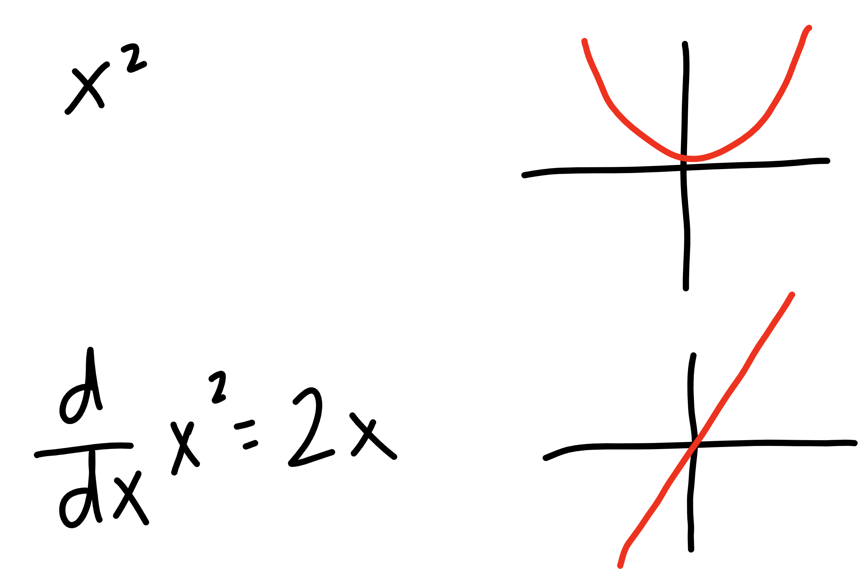


Slide 29







learning
rate
updated W
derivative of
cost function
current W

Slide 30

learning
rate
gradient of
cost function
updated W
current W

Slide 31








learning
rate
gradient of
cost function
updated W
current W

Slide 32


learning
rate
gradient of
cost function
updated b
current b

Slide 33
Let’s try it out!
simple numpy sanity check

Slide 35



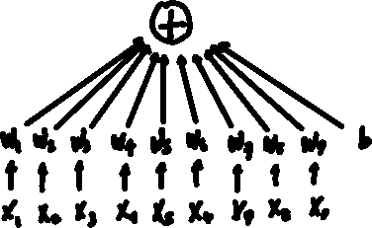

top
middle
bottom

Slide 36
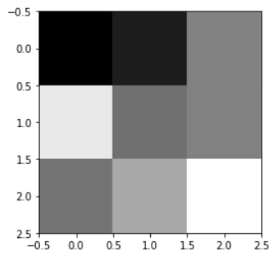
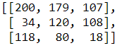




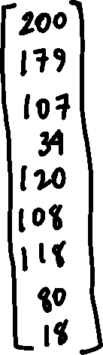


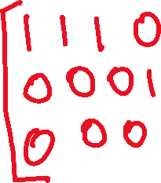
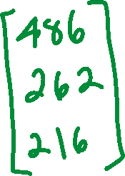

Slide 37






Slide 38
Let’s try it out – PART DEUX!
simple numpy sanity check

Slide 40






Slide 41
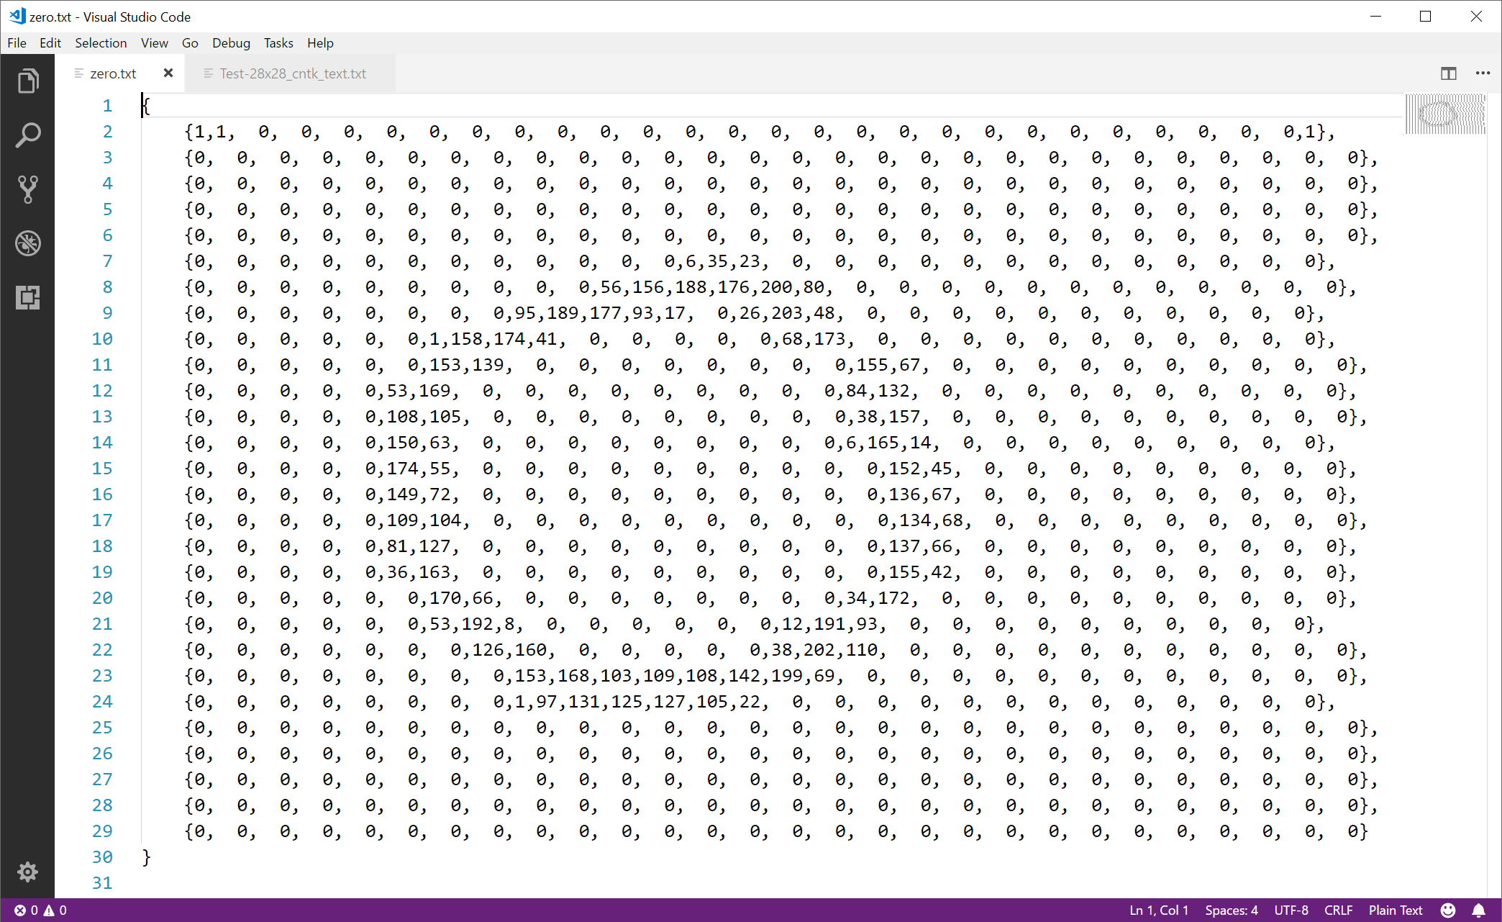

Slide 42
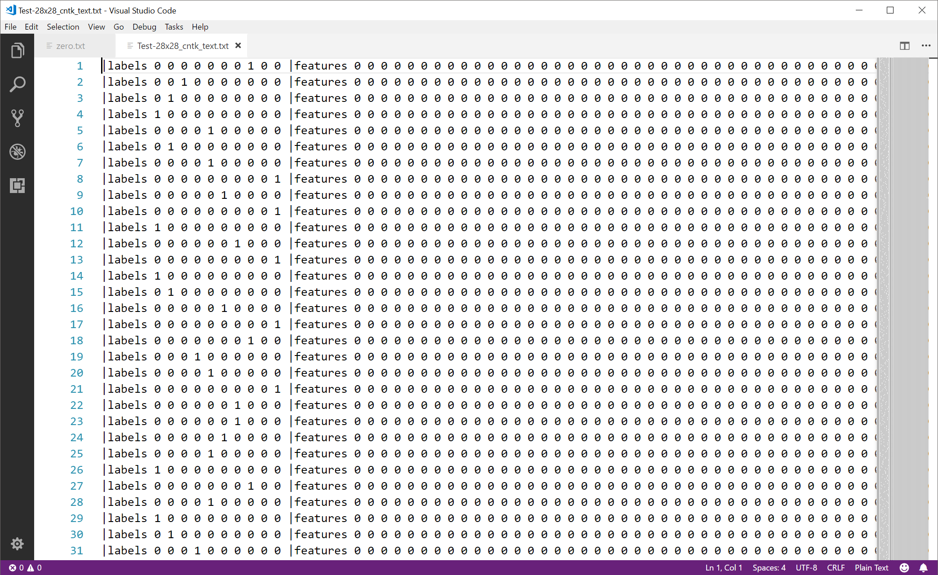

Slide 44
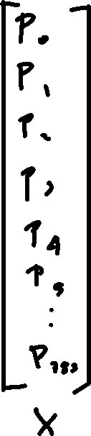
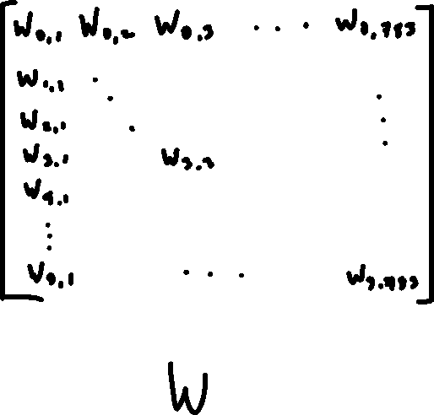
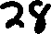


Slide 45
Let’s try it out – PART TROIS!
simple numpy sanity check

Slide 46


Slide 47


